Slide 1
Ch. 12: Patricia

Slide 2
Patricia
Practical Algorithm To Retrieve Information Coded In Alphanumeric.
Compressed binary trie.
All nodes are of the same data type (binary tries differentiate branch and element nodes).
Pointers to only one kind of node.
Simpler storage management.

Slide 3
Patricia (cont’d)
Uses a header node.
Remaining nodes define a trie structure that is the left subtree of the header node.
Trie structure is the same as that for the compressed binary trie of previous lecture.

Slide 4
Node Structure
bit#
LC
Pair
RC
bit# = bit used for branching // key
LC = left child pointer
Pair = dictionary pair // value
RC = right child pointer

Slide 5
Compressed Binary Trie to Patricia
Move each element into an ancestor or header node.
1
0
1
3
2
0
1
0
1
0001
0011
4
4
答: 資料必需存在搜尋路徑能找到的地方!
0
1
0
1
// 將黃色節點視為external node
// #(黃色)=#(橘色)+1
1000
1001
1100
1101
Notes:
Replace each branch node with a Patricia node.
Then move elements into ancestor Patricia nodes.
There will always be one more element node than there are branch/Patricia nodes.
The header nodes saves us by providing place for the additional element.

Slide 6
Compressed Binary Trie To Patricia
0
0001
1
1101
0
1
3
0011
2
1001
0
1
0
1
4
4
1000
1100
1
0
1
0
Notes:
Red pointer (pointer to element or backward pointer) ends at a smaller or equal bit number than it starts at. Original pointers (forward pointers) end at a larger bit number.

Slide 7
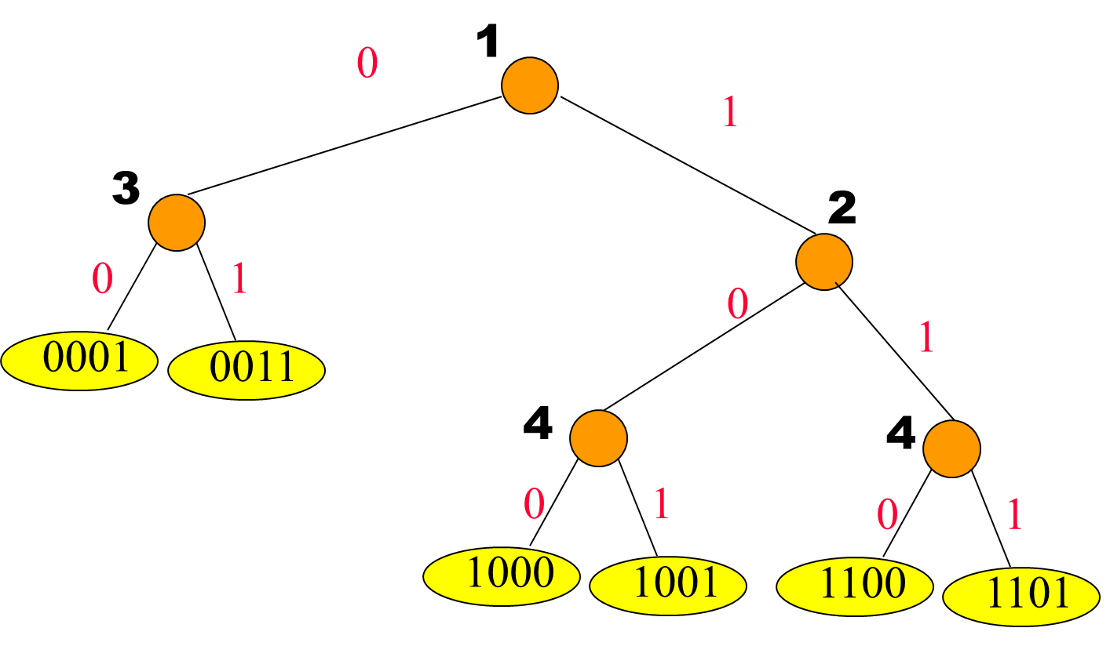
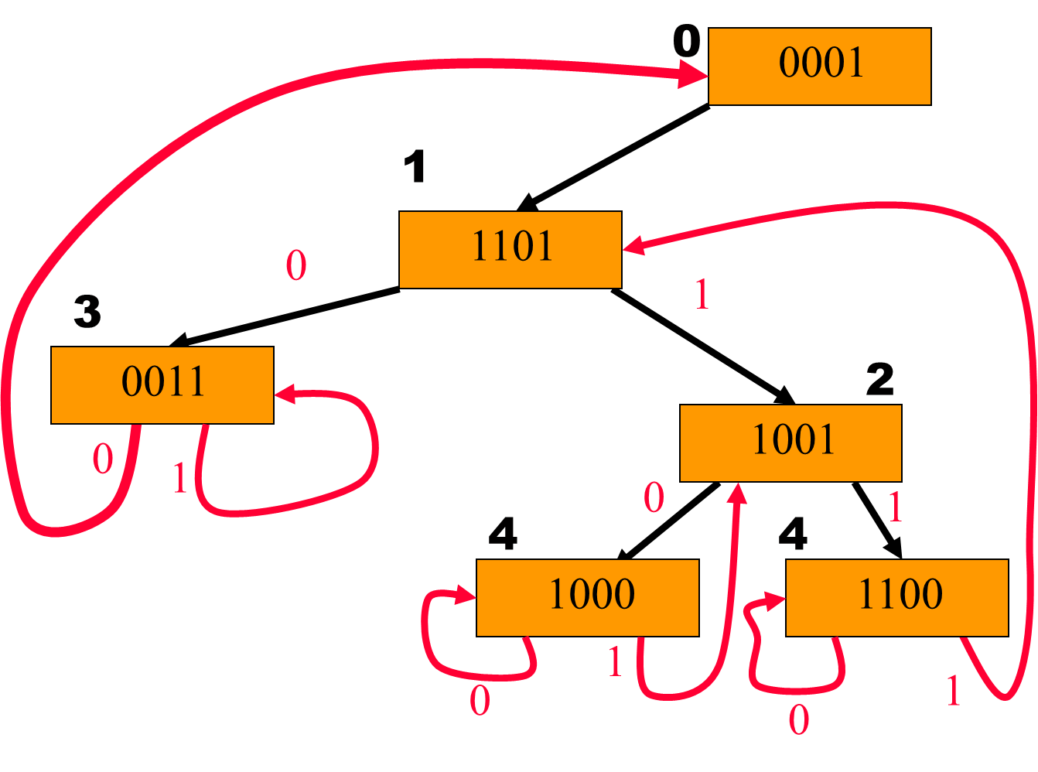


Compressed trie
Patricia
請檢視一下黑邊 (in patricia)
請檢視一下紅邊 (in patricia)

Slide 8
Pointers in Patricia
所有external nodes (data items) 的個數為branch nodes的個數 “加一”，因此需要一個額外的header來儲存某一個leaf的data item
Black pointer: 原來在compressed tries裡的邊 (搜尋用的)，除了root出來那個黑邊
Red pointer: 儲存在external node裡的data將被安排在其 “至” root的路徑上當中的 “某一” 節點儲存 (say, p)，red pointer指標則指向p
Red pointer為搜尋過程中的最後一哩路 (last mile)
一資料會安排在哪個branch node需視資料插入Patricia的 “次序” 而定 (即使同一組資料，其插入順序不同，則所得的Patricia也可能會不同)

Slide 9
Search(key)
只看key的第bit#，直到走到了red pointer所指向的branch node (亦即抵達了對應compressed trie的leaf data node)
往 “遞增bit#” 的方向搜尋 (可能數次的black pointers)，最終使用了一次red pointer
最後那一個red pointer到達的節點其bit#將小於等於倒數第二個路徑節點的 (因該red pointer指向了往root方向路徑上的branch node) // 判斷是否走到了red pointer
Red point是方便我們講解用，其實不需要定義邊的顏色
Root沒有選擇，必定往其left child (bit# = 0)搜尋

Slide 10
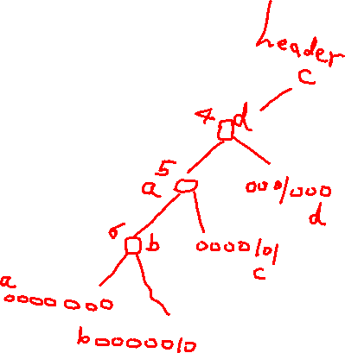
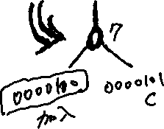
How to Insert 0000100?
0
Compressed
tries
Patricia
0000101
4
0001000
5
0000000
6
0000010

Slide 11
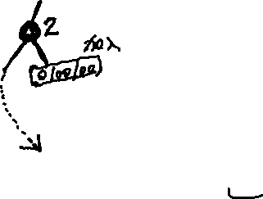
How to Insert 0100100?
0
0000101
0100100
4
0001000
0100100
5
0000000
6
0000010

Slide 12
Insert的概念 (請轉換成Compressed Tries來理解這些步驟)
給定要插入的key x
Step 1: 從root開始在Patricia裡搜尋並停止在branch node, y
y所儲存的key為對應在compressed trie的leaf node中的key
(本步驟乃在探索x加入後如何影響Patricia的結構)
(只走黑邊)
Step 2: 找出x和y的common prefix
Step 3: 以上述common prefix從root開始再搜尋Patricia一次使確定何處插入一新的的branch node
(意圖在compressed trie裡建立一個branch node)
Step 4: 新增branch node 、新增及調整必要的指標、加入x至該branch node、填入common prefix length+1的長度到bit#

Slide 13
Insert
0
Insert 0000101
0000101
0
Insert 0000000
0000101
new
5
0000000

Slide 14
Insert
before
0
0000101
Insert 0000010
5
0000000
new
6
0000010
after
Notes:
看第6個bit
if 0 leftchild指到自己
If 1 rightchild指到自己
K插在p及r之間 (p是r的parent)

Slide 15
Insert
0
0000101
0
0000101
5
0000000
4
0001000
6
0000010
5
0000000
6
0000010
Insert 0001000

Slide 16
Insert
0
0000101
4
0001000
5
0000000
6
0000010
Insert 0000100

Slide 17
Insert
0
0000101
4
0001000
5
0000000
new
7
6
0000010
0000100
Insert 0001010

Slide 18
Insert
0
0000101
4
0001000
new
5
6
0000000
0001010
7
6
0000010
0000100

Slide 19
Delete
Let p be the node that contains the dictionary pair that is to be deleted.
Case 1: p has one self pointer.
p搶到了parent的位置
Case 2: p has no self pointer.
p沒搶到parent的位置 (而被安排在某個ancestor的位置)

Slide 20
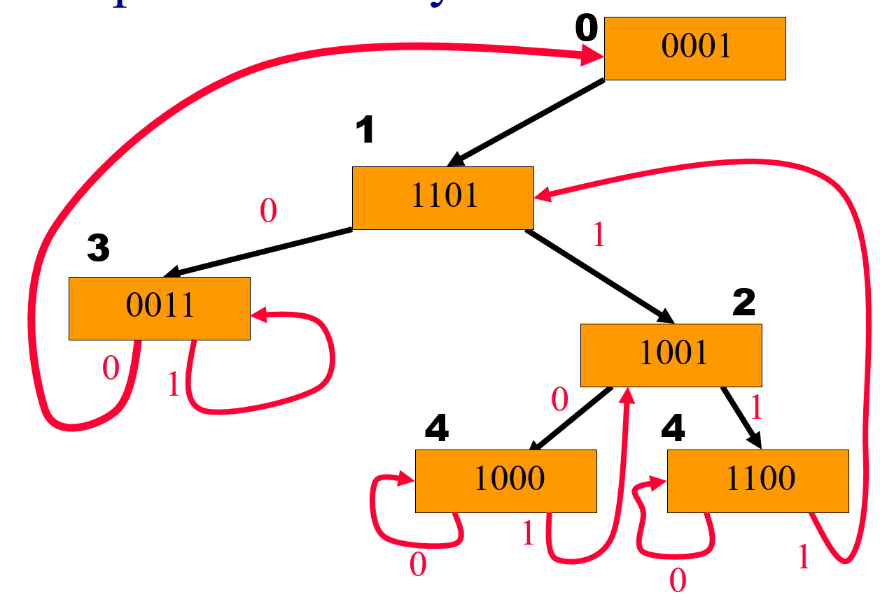
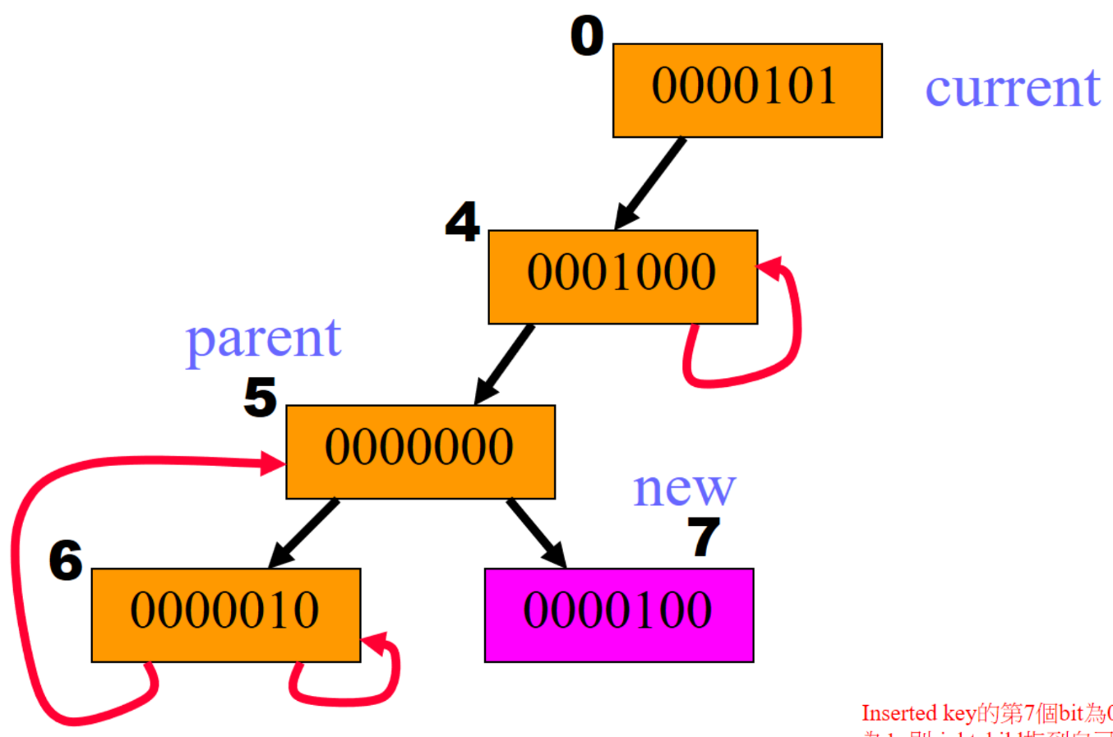
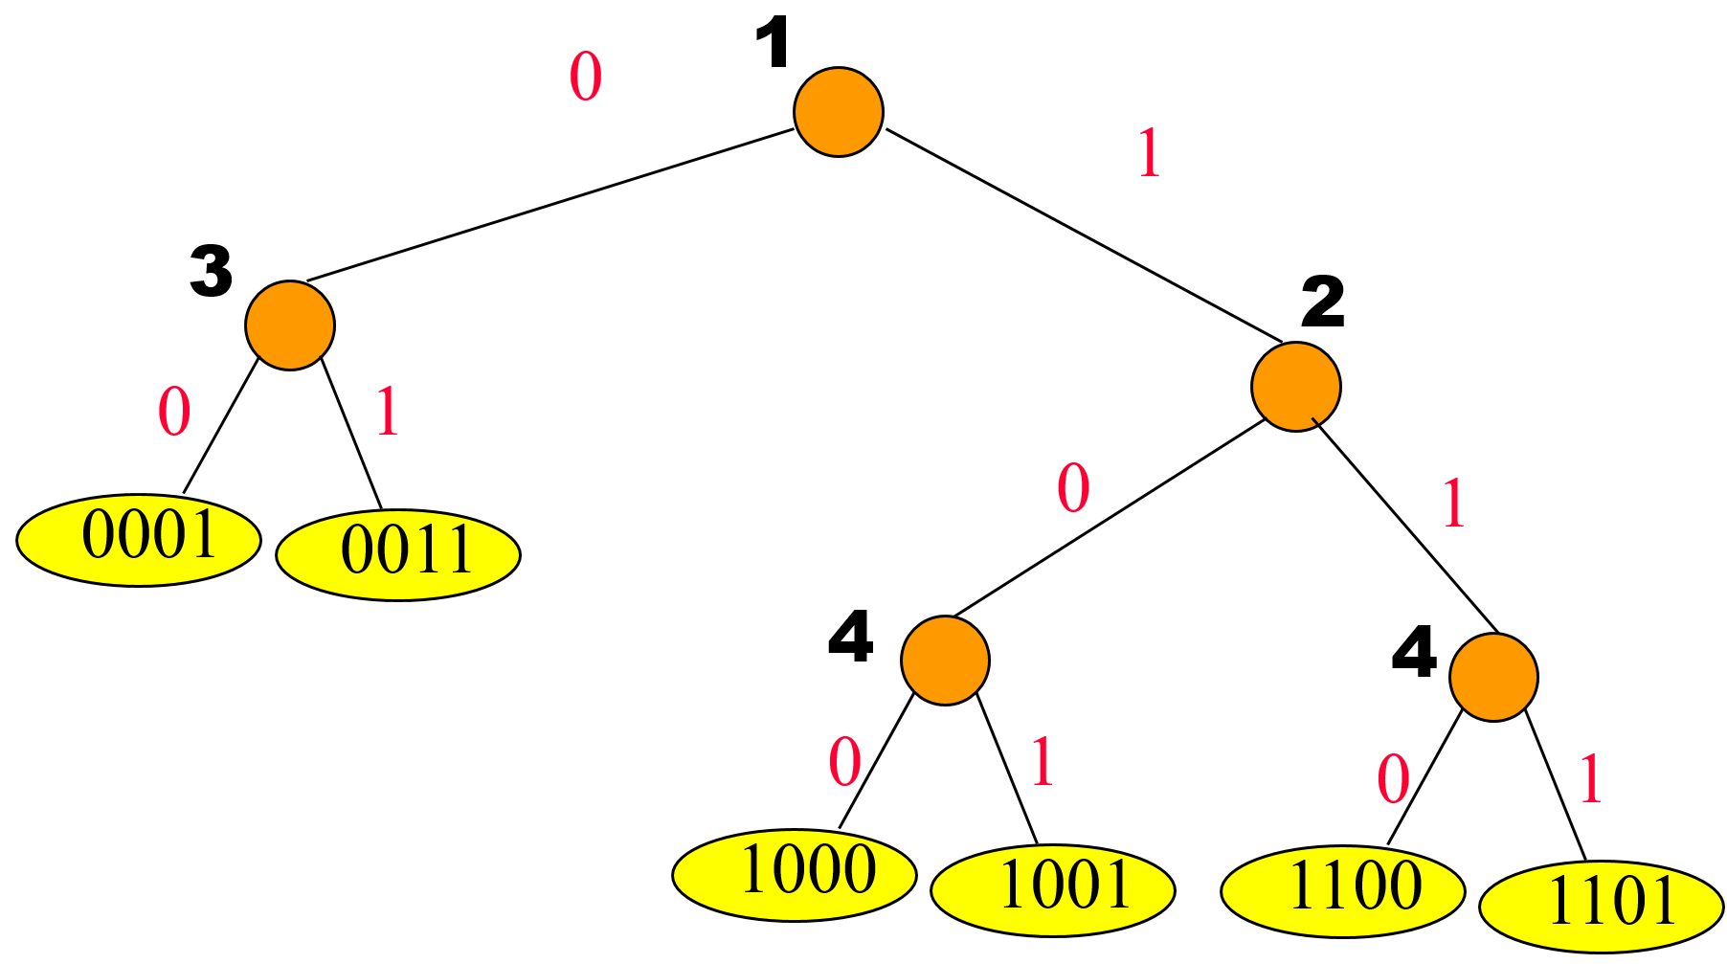
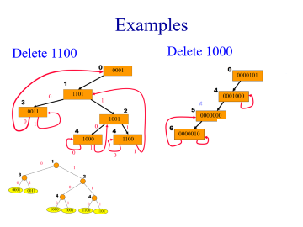
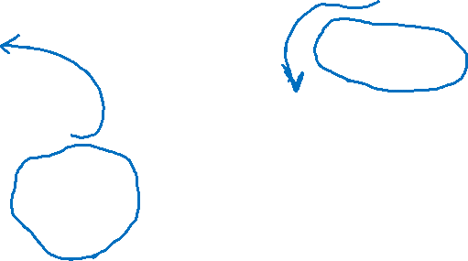
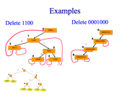
Examples
Delete 1100
Delete 0001000

Slide 21
p Has One Self Pointer (p is to deleted)
p = header => trie is now empty.
Set trie pointer to null.
p != header => remove node p and update pointer to p.
p
p
0001000
0000000

Slide 22
Delete
Let p be the node that contains the dictionary pair that is to be deleted.
Case 1: p has one self pointer.
p搶到了parent的位置
Case 2: p has no self pointer.
p沒搶到parent的位置 (而被安排在ancestor的位置)

Slide 23

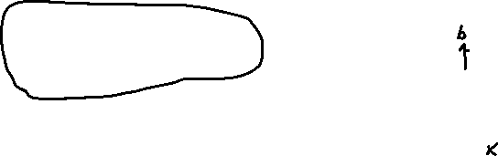
Example (Delete 0000000)
Step 1: 找到a (i.e., 0000000)
Step 2: 找到與a相像的資料b，且當時b贏了a而佔住了一branch node (in terms of common prefix)
Step 3: 刪除一branch node (i.e., 綠色的b) (in corresponding compressed tries), representing a與b的maximum common prefix
Step 4: b取代a (a所在的branch node改為儲存b的資料)
Steps 1 & 2在探索tries的結構!!!
0
0000101
4
0001000
5
0000000
6
0000010

Slide 24
Example (Delete 0000101)
0
0000101
4
0001000
5
0000000
6
0000010
Step 1: 找到c (i.e., 0000101)
Step 2: 找到與c相像的資料a (or b)，且當時a (not b) 贏了c而佔住了一branch node (in terms of common prefix)
Step 3: 刪除一branch node (i.e., 綠色的a) (in corresponding compressed tries)
Step 4: a取代c (c所在的branch node改為儲存a的資料)

Slide 25
p Has No Self Pointer (Delete 0001000)
Let q be the node that has a back (red) pointer to p.
Node q was determined during the search for the pair with the deleted key k.
p
0001000
Blue pointer could be red or black.
q
y
我們說的Step 1
Notes:
Node q will be deleted! Move y to p and change back pointer to q so that it is a back pointer to p.

Slide 26
p Has No Self Pointer
p
0001000
q
y
我們說的Step 2
r
z
//參考insert搜尋的方式
Use the key y in node q to find the unique node r that has a back pointer to node q.
Notes:
Note that q and r may be the same node.

Slide 27
p Has No Self Pointer
p
0001000
y
q
y
r
z
Copy the pair whose key is y to node p.

Slide 28
p Has No Self Pointer
p
0001000
y
q
y
r
z
Change back pointer to q in node r to point to node p.

Slide 29
p Has No Self Pointer
p
0001000
y
q
y
r
z
Node q now has been removed from trie.
Change forward pointer to q from parent(q) to child of q.

Slide 30
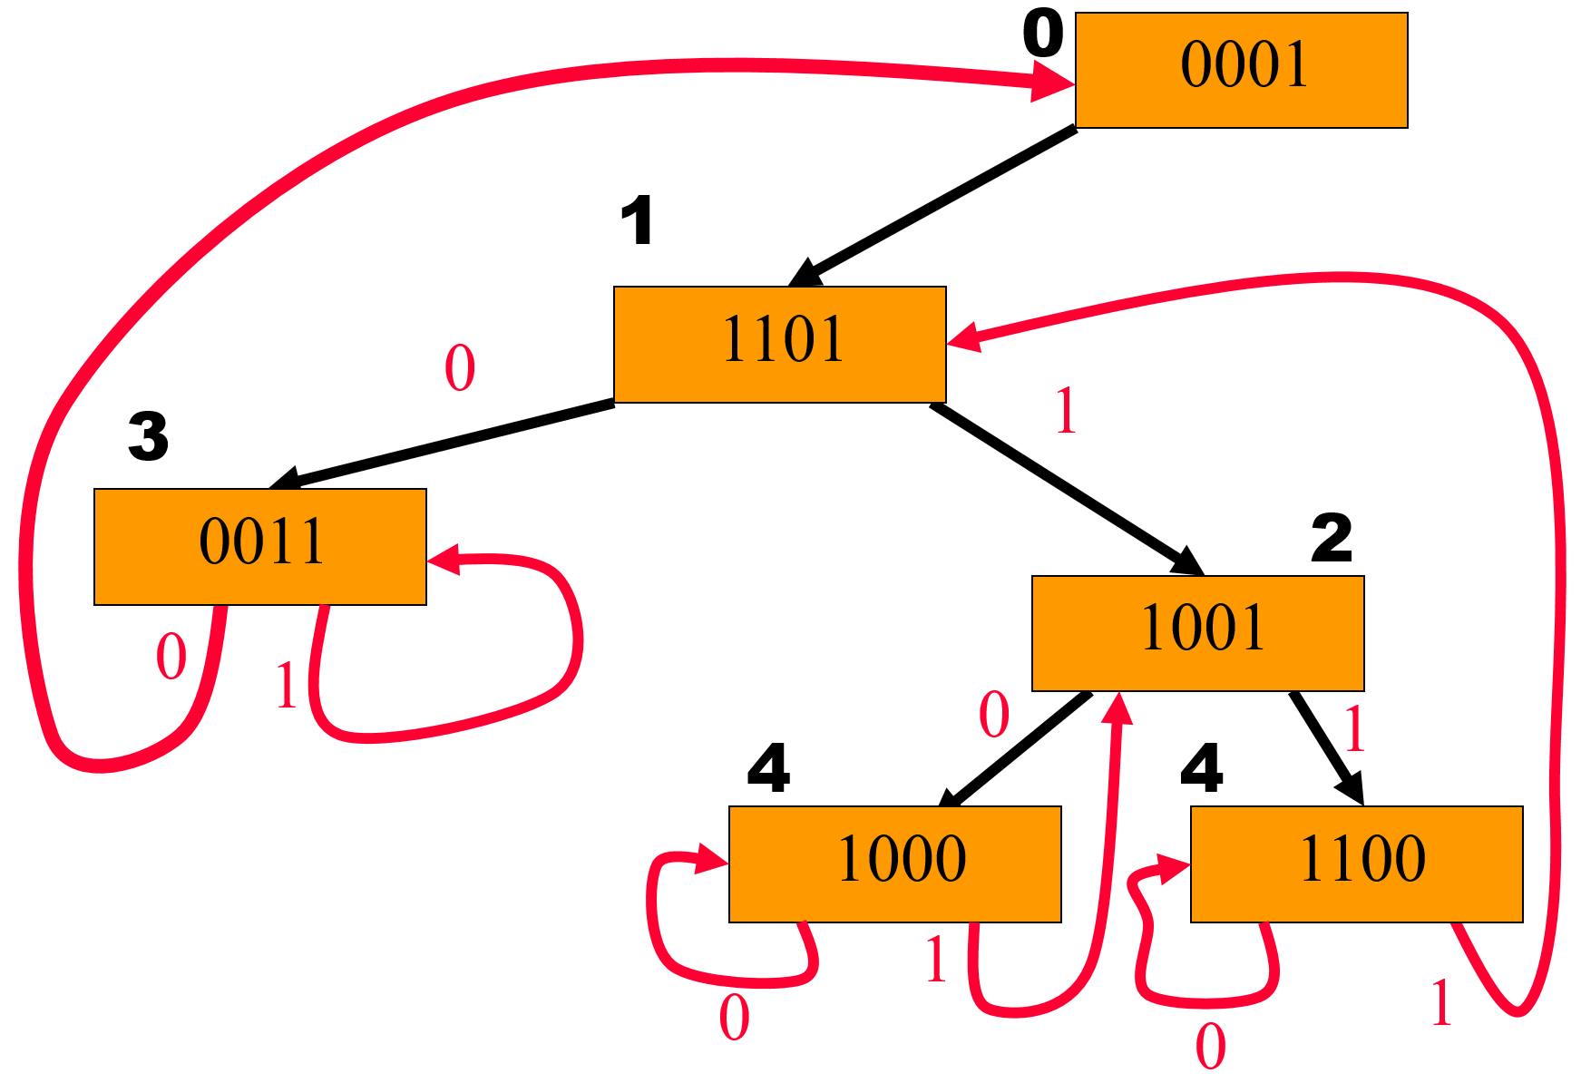
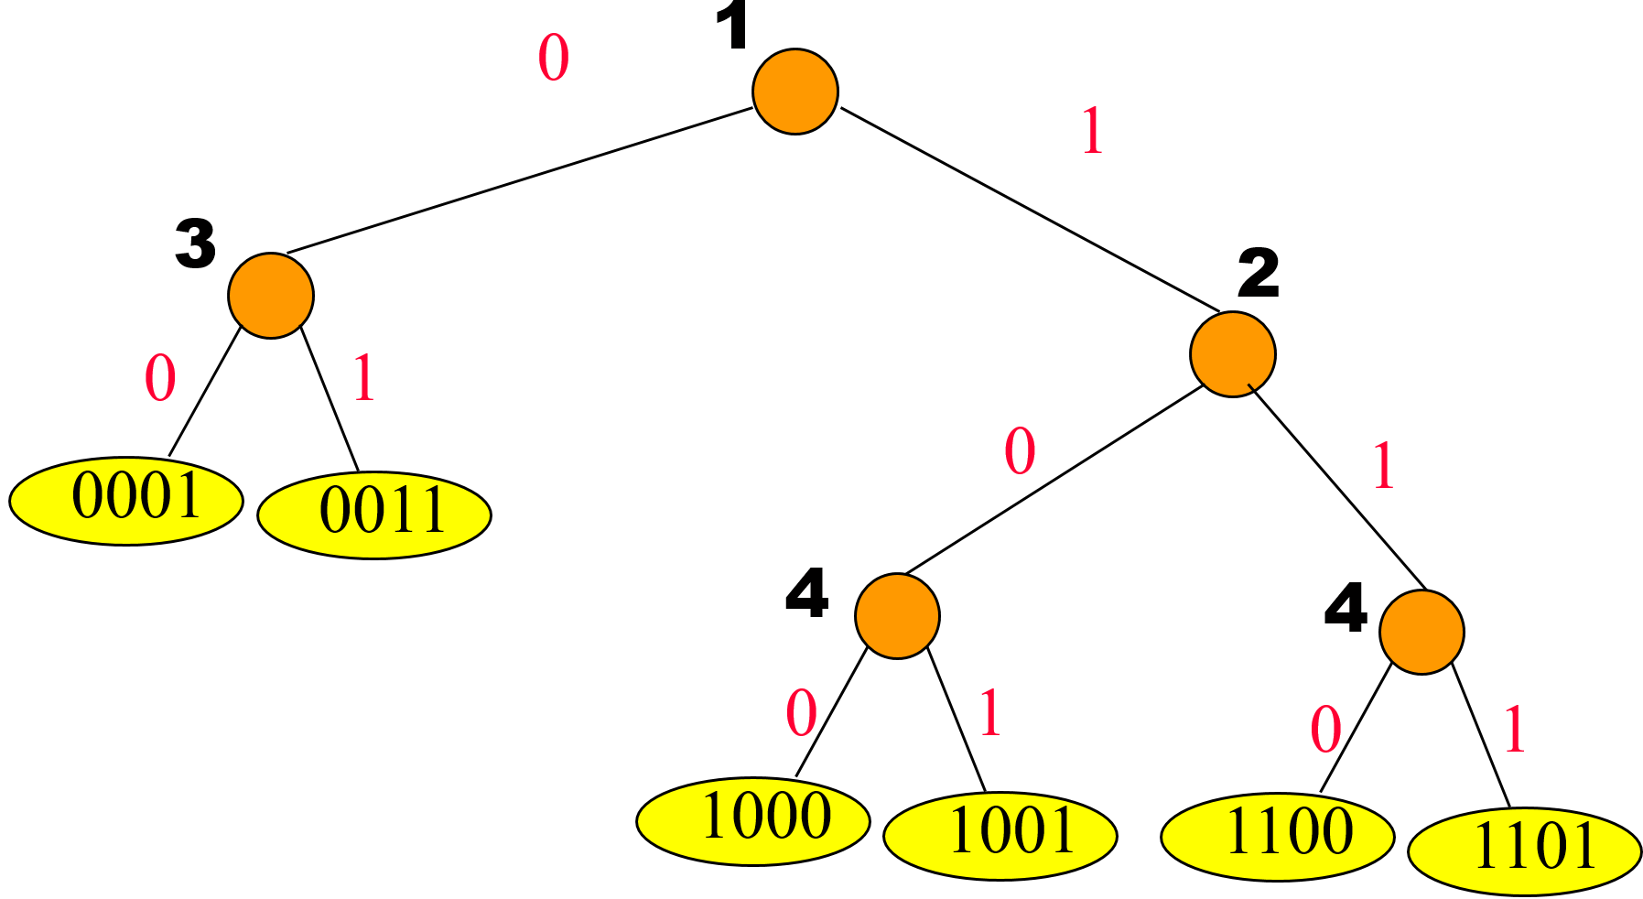

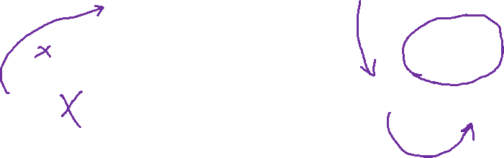
Another Example (Delete 1001)
這裡y剛好就是1000

Slide 31
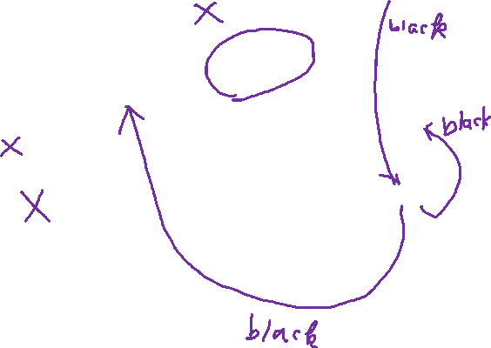
Example (Delete 1101)

